Slide 1
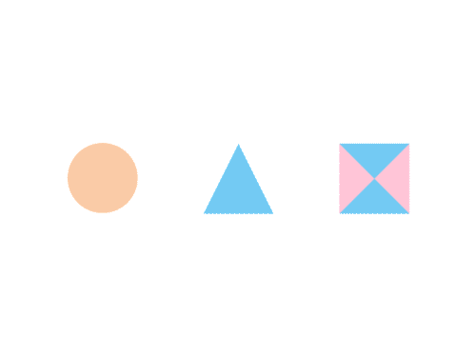

CSE 591 Visual Perception
Ross Maciejewski
rmacieje@asu.edu

Slide 2
Color
Results from research on visual attention can be used to assign visual features to data values
One of the key components of visually representing data is choosing the appropriate color scale
There is no “best” color scale
Choice depends on^{1,2}
data type
problem domain
visual representation
Questions the analyst is asking of the data
While there is no “best” choice, there are design principles
1 - H. Levkowitz and G. T. Herman, "Color scales for image data," IEEE Computer Graphics and Applications, vol. 12, pp. 72-80, 1992
2 - P. Rheingans, "Task-based color scale design," Proceedings of Applied Image and Pattern Recognition, pp. 35-43, 1999.

Slide 3
Design Principles for Color Schemes
Order¹ – Given a univariate data type, the color scale that is chosen to map the data must represent a perceived ordering
Separation² – Important differences between ranges of the variable should be represented by colors that can be perceived as being different
Not only should they be perceived as different, but also equal
Aesthetics³ – color map should be aesthetically pleasing, contain a maximum perceptual resolution, and ordering should be intuitive
1 - B. E. Trumbo, “Theory for Coloring Bivariate Statistical Maps," The American Statistician, vol. 35, no. 4, pp. 220-226, 1981.
2 - H. Levkowitz and G. T. Herman, "Color scales for image data," IEEE Computer Graphics and Applications, vol. 12, pp. 72-80, 1992
3 - K. Moreland, “Diverging Color Maps for Scientific Visualization," Proceedings of the 5th International Symposium on Visual Computing, December 2009.

Slide 4


Univariate Color Schemes
Qualitative scheme
Rainbow color scale is one of the most commonly used, but it is a poor color map in a large variety of domain problems
Ordering of the hues is unintuitive
Nominal data types can use this scale as no ordering is implied
1 - D. Borland and R. M. Taylor, “Rainbow Color Map (Still) Considered Harmful,“ Computer Graphics & Applications, vol. 27, no. 2, pp. 14-17, 2007.
2 -P. Rheingans, “Task-based color scale design," Proceedings of Applied Image and Pattern Recognition, pp. 35-43, 1999.
3 - M. A. Harrower and C. A. Brewer, “ColorBrewer.org: An online tool for selecting color schemes for maps," The Catrtographic Journal, vol. 40, no. 1, pp. 27-37, 2003.

Slide 5

Univariate Color Schemes
Sequential color scheme
Simplest is the gray scale map where variable is mapped to brightness
Sequential maps represent ordered data
Dark colors typically represent high ranges, bright, low
Benefits are that the scale is intuitive
Weakness is that limited number of distinguishable colors can be represented
1 - D. Borland and R. M. Taylor, “Rainbow Color Map (Still) Considered Harmful,“ Computer Graphics & Applications, vol. 27, no. 2, pp. 14-17, 2007.
2 -P. Rheingans, “Task-based color scale design," Proceedings of Applied Image and Pattern Recognition, pp. 35-43, 1999.
3 - M. A. Harrower and C. A. Brewer, “ColorBrewer.org: An online tool for selecting color schemes for maps," The Catrtographic Journal, vol. 40, no. 1, pp. 27-37, 2003.

Slide 6
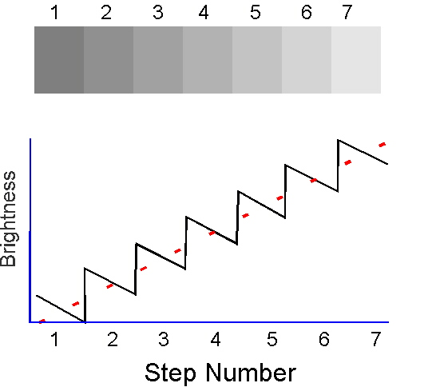


Illusions in Grayscale
Adelson, E.H. (2000). Lightness Perception and Lightness Illusions. In M. Gazzaniga, M.S., ed., The New Cognitive Neurosciences, 2nd Ed., Cambridge, MA: MIT Press, pp. 339-351.
http://www.blelb.ch/english/blelbspots/spot28/exspot28_en.htm

Slide 7

Univariate Color Schemes
Divergent color scheme
Provides means for variable comparisons
Best suited for ratio data where there is some meaningful zero point
Scale lacks a natural ordering of colors
Careful choices must be made in choosing high and low ends
Can use concept of cool (blues) and warm (reds and yellow) colors
1 - C. Hardin and L. Maffi, Color Categories in Thought and Language, Cambridge University Press, 1997.
2 -P. Rheingans, “Task-based color scale design," Proceedings of Applied Image and Pattern Recognition, pp. 35-43, 1999.
3 - M. A. Harrower and C. A. Brewer, “ColorBrewer.org: An online tool for selecting color schemes for maps," The Catrtographic Journal, vol. 40, no. 1, pp. 27-37, 2003.

Slide 8
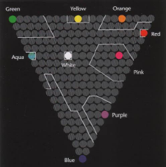
Color Categories
Are there certain canonical colors?
Post & Green¹ had people name different colors on a monitor
Pictured are those with 75% commonality²
1 - DL Post and FA Greene, “Color Naming as a Function of Stimulus Luminance, Angular Subtense and Practice,” Proceedings of the Human Factors and Ergonomics Society Annual Meeting October 1985 vol. 29 no. 11 1070-1074
2 - Information Visualization by Colin Ware, Morgan Kaufmann, 2004.
3 – Information on this slide borrowed from John Stasko’s Visual Perception Lecture: http://www.cc.gatech.edu/~stasko/7450/Notes/perception.pdf

Slide 9
Color Categories
Color categories may not be all the same
The Himba people of Namibia see colours differently to Westerners: http://www.eversostrange.com/2011/08/11/himba-colours-differently/
Language may also affect color perception: http://boingboing.net/2011/08/12/how-language-affects-color-perception.html
Information on this slide borrowed from John Stasko’s Visual Perception Lecture: http://www.cc.gatech.edu/~stasko/7450/Notes/perception.pdf

Slide 10
Multivariate Color Schemes
V₂
V₂
V₃
V₁
V₁
M. A. Harrower and C. A. Brewer, “ColorBrewer.org: An online tool for selecting color schemes for maps," The Catrtographic Journal, vol. 40, no. 1, pp. 27-37, 2003.

Slide 11
Using Color
Use blue in large regions, not thin lines
Use red and green in the center of the field of view (edges of retina not sensitive to these)
Use black, white and yellow in the periphery
Use adjacent colors that vary in hue and value
For large regions, don’t use highly saturated colors (try pastels)
Do not use adjacent colors that vary in amount of blue
Don’t use high saturation, spectrally extreme colors, together, this can cause after imaging
Use color for grouping and search
Beware effects from adjacent color regions
Information on this slide borrowed from John Stasko’s Visual Perception Lecture: http://www.cc.gatech.edu/~stasko/7450/Notes/perception.pdf

Slide 12
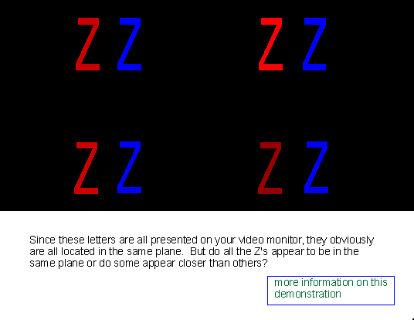
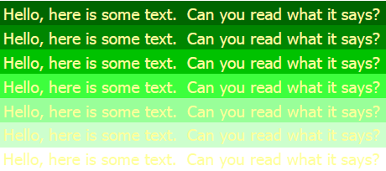
Using Color
Information on this slide borrowed from John Stasko’s Visual Perception Lecture: http://www.cc.gatech.edu/~stasko/7450/Notes/perception.pdf

Slide 13
How Not to Use Color
http://www.thedailyshow.com/video/index.jhtml?videoId=156230&title=full-color-coverage

Slide 14
Definitions
Dominant Wavelength:
The wavelength of color we “see” when viewing light
Excitation Purity:
Proportion of pure light of the dominant wavelength and of white light needed to define the color
Luminance:
The amount/intensity of light

Slide 15
Definitions
Hue:
What we usually call “color” of the light
Saturation (chroma)
Amount of white mixed in the color
“Saturated” color has no white in it
Saturation of white is 0%
Intensity
Lightness for reflecting objects
Brightness for self- luminous objects
Is proportional to energy
May be reduced by adding water to the color
Artists use hue, saturation and intensity to describe colors.

Slide 16
The “Trichromatic Theory” of Color Perception
Light has no color
Color is a perceptual phenomenon
The trichromatic theory:
The human retina has three kinds of color sensors (the “cones”), with peak sensitivity to red (R), green (G), or blue (B) lights.
Cones are active when there is enough light
Rods operate in the dark.
There is no color perception in darkness.

Slide 17
Opponent Color Theory
Certain phenomena can not be explained by trichromatic color
Why don’t we see reddish greens or yellowish blues ?
Neural processing of trichromatic values yields 2 major opponent color classes
Spectrally opponent processes (channels)
Red/Green Channel: difference of the red and green cone signals
Yellow/Blue Channel: difference of the blue cones and the sum of red+green
1878, the physiologist Ewald Hering published his On the Theory of Sensibility to Light in Vienna

Slide 18
Opponent Color Theory (cont.)
Luminance : Spectrally non-opponent process (black vs. white)
based on input from all cones
Greater sensitivity to luminance than chrominance
Greatest bandwidth for conveying information
Chrominance sensitivity decreases with low luminance

Slide 19
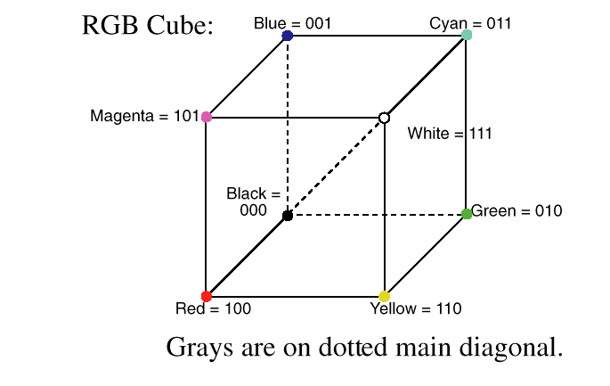
RGB Color Space

Slide 20
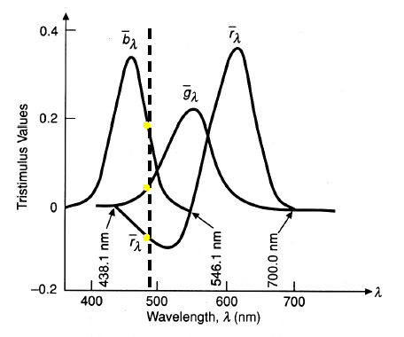
RGB
Does Not Produce All Colors
Why do painters need more than RGBs on their color palette?
In order to match all the wavelengths of the visible spectrum, a negative amount of paint might be needed

Slide 21
CMYK: Subtractive Colors
Hardcopy devices, such as inkjet plotters, deposit colored pigments (CMY, or CMYK, or CMYK + lightC + lightM) onto paper.
These pigments absorb their complementary color from the reflected white light
In contrast, think of additive colors as adding color to blackness.

Slide 22
Additive and Subtractive Colors
Cyan, Magenta and Yellow are the complements of Red, Green and Blue respectively.
For example, cyan subtracts red from white, C=W-R (Subtractive Equation)
Since W=R+G+B, it must be that C=G+B (additive equation).
Similarly, we have M=W-G, M=R+B, and Y=W-B, Y=R+G

Slide 23
Color Models & Color Spaces
Need to specify colors by the mixture of three fixed primaries
RGB is a good candidate, but negative weights are awkward
A synthetic set of standard primaries, XYZ, were created

Slide 24
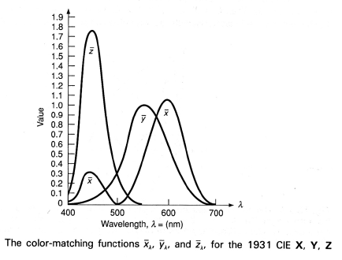
The CIE Chromaticity Space
CIE stands for the Commission Internationale de l’Eclairage
The “standard primaries” XYZ are defined by
How they can be combined to match ANY visible color
Not by their spectral density functions

Slide 25
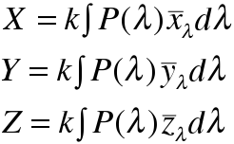
P(λ) to XYZ
Given the spectral energy density of P(λ) of a color, the amounts of X, Y, and Z primaries needed to match the color are simply:
The value of k depends on the device
X, Y, Z are numbers (>=0)
For a given Color C, we have C = X*X+Y*Y+Z*Z, where C, X, Y, Z can be thought of as P(λ) functions

Slide 26
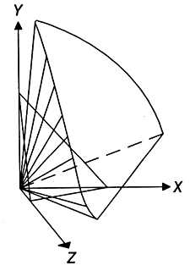
Chromaticity Values
In the XYZ space, we only care about the positive quadrant.
PQS is called the chromaticity plane
The projection of this plane on the XYZ plane is the chromaticity diagram

Slide 27
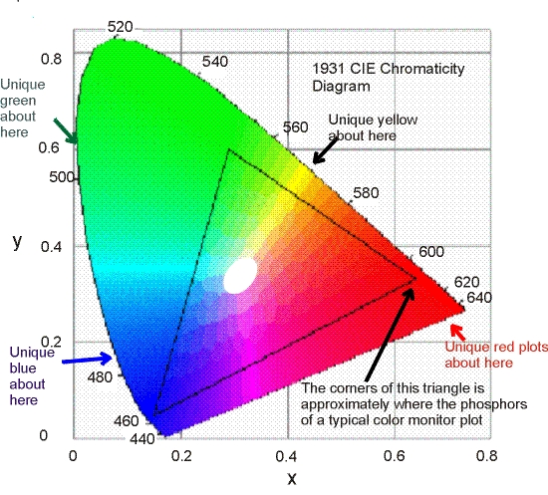
CIE Chromaticity Diagram
Wyszecki, G., Stiles, W.S. 1982. Color Science, John Wiley & Sons, 1982

Slide 28
Using the Chromaticity Diagram
The chromaticity diagram allows us to measure the dominant wavelength and excitation purity of any color by matching the color with a mixture of the three CIE primaries.
Instruments called colorimeters measure tristimulus X, Y, and Z values, from which chromaticity coordinates xyz are computed.

Slide 29
The Missing Color
Brown, an orange-red chromaticity at very low luminance relative to its surrounding area, does not appear in the chromaticity diagram.
Thus remember: chromaticity diagram is not a full color palette.
There is an infinite number of planes in the XYZ space, each of which projects onto the chromaticity diagram, and each of which loses luminance information in the process.
The colors found on each such plane are all different

Slide 30
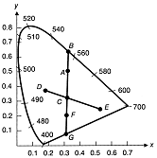
Using the Chromaticity Diagram (cont.)
We can use the chromaticity diagram to find complementary colors.
Complementary colors are those that can be mixed to produce white light
For example, Cyan/Red, Magenta/Green, and Yellow/Blue

Slide 31
Using the Chromaticity Diagram (cont.)
We can also use the chromaticity diagram to find nonspectral colors.
Colors on the bottom straight line cannot be defined by a dominant wavelength (e.g., purple)
The dominant wavelength of a nonspectral color F = the complement of the wavelength at which F and C intersect.

Slide 32
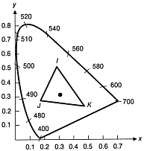
Using the Chromaticity Diagram (cont.)
We can use the chromaticity diagram to study color gamuts.
Color gamuts/ranges can be defined on the chromaticity diagram to show the effect of adding several colors together.
All colors on the line IJ can be created by mixing colors I and J.
All colors in the triangle IJK can be created by mixing colors I, J, and K.
A triangle connecting RGB shows all the colors that can be displayed by a CRT.
Since no triangle whose vertices are within the visible area can completely cover the visible area, we conclude that CRT cannot display all visible colors.

Slide 33
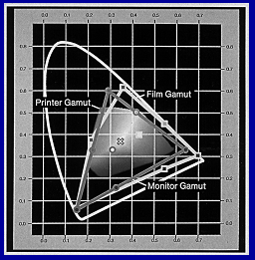
Using the Chromaticity Diagram (cont.)
The chromaticity diagram is used as a standard to characterize color display and hardcopy devices.

Slide 34
What’s Wrong with RGB?
Interpolation in RGB will not give correct perceptual information
RGB linear color maps will give incorrect information
What about vector interpolation of RGB?
Is there something better and quicker?
Approximations based on table look-ups

Slide 35
Possible Alternative for RGB Interpolation
Use Opponent Color Model
R-G
B-Y
Luminance
Use Hue, Saturation, and Value
Can you understandably display three variables using these techniques?

Slide 36
More Color Issues
Viewing on a CRT:
Non-linear device
Luminance = voltage^{gamma}
Small range of luminance values compared to visual sensitivity
Perceived brightness is non-linear function of amount of light emitted by source
Typically a power function
Very different on screen versus paper

Slide 37
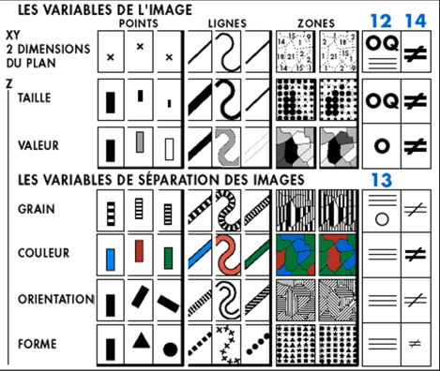
Other Visual Features
J Bertin (1967), The Semiology of Graphics

Slide 38
Texture
Combination of visual variables
Orientation
Scale
Contrast
There are a number of trade-offs in the density with which information can be displayed using textures
Trade-off between size of texture elements and the precision with which the location can be specified
The precision with which the texture orientation can be specified and the precision with which texture size can be specified
C. Ware and W. Knight, “Using Visual Texture for Information Display,” ACM Transactions on Graphics, 14(1):3-20

Slide 39
Glyph Construction
Suppose that we use two different visual properties to encode two different variables in a discrete data set
Color, size, shape, lightness
Will the two different properties interact so that they are more/less difficult to untangle?
Integral – two properties are viewed holistically
Separable – can judge each dimension independently
Information on this slide borrowed from John Stasko’s Visual Perception Lecture: http://www.cc.gatech.edu/~stasko/7450/Notes/perception.pdf

Slide 40
Feature Interference
There are visual features that dominate others creating a hierarchy of
Hue and luminance are strong features
Curvature is a weak feature
Understanding this feature hierarchy is critical to ensuring that less important attributes are not hidden
1 - C. Healey and J. Enns, “Attention and Visual Memory in Visualization and Computer Graphics”, IEEE Transactions on Visualization and Computer Graphics, 2011 (Pre-print)
2 - T. C. Callaghan, “Interference and dominance in texture segregation,”in Visual Search, D. Brogan, Ed. New York, New York: Taylor & Francis, 1990, pp. 81–87.
3 - T. C. Callaghan, “Dimensional interaction of hue and brightness in preattentive 􀃀eld segregation,” Perception & Psychophysics, vol. 36, no. 1, pp. 25–34, 1984.
4 - T. C. Callaghan, “Interference and domination in texture segregation: Hue, geometric form, and line orientation,” Perception & Psychophysics, vol. 46, no. 4, pp. 299–311, 1989.

Slide 41
Current Challenges
Visual acuity –what is the information processing capacity of the visual system?
How much information can a feature represent
Aesthetics – can we measure or control aesthetic improvements to enhance visualization
Engagement – how can we design our visualizations to best engage the viewer
1 - C. Healey and J. Enns, “Attention and Visual Memory in Visualization and Computer Graphics”, IEEE Transactions on Visualization and Computer Graphics, 2011 (Pre-print)

Slide 42
Readings and Homework
Require Readings:
M. Stone, "Choosing Colors for Data Visualization", 2006.
Borkin, M.; Gajos, K.; Peters, A.; Mitsouras, D.; Melchionna, S.; Rybicki, F.; Feldman, C.; Pfister, H.; , "Evaluation of Artery Visualizations for Heart Disease Diagnosis," Visualization and Computer Graphics, IEEE Transactions on , vol.17, no.12, pp.2479-2488, Dec. 2011. doi: 10.1109/TVCG.2011.192
Homework:
Milestone #1 is due Wednesday!

Slide 43
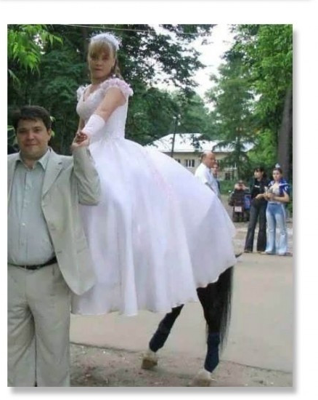
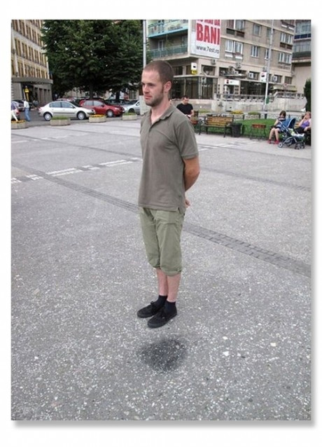
Photo Illusions: Capturing the Right Moment and Perspective
http://weknowmemes.com/2011/12/photo-illusions-capturing-the-right-moment-and-perspective/

Slide 44
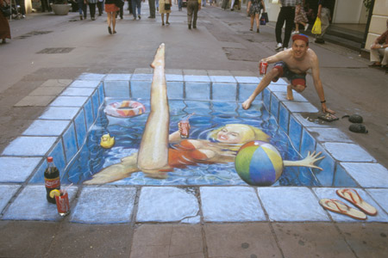
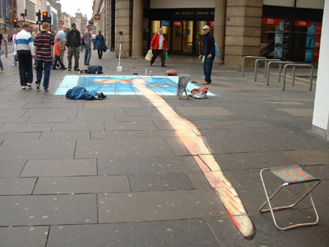
Sidewalk Art
Images by Julian Beever

Slide 45
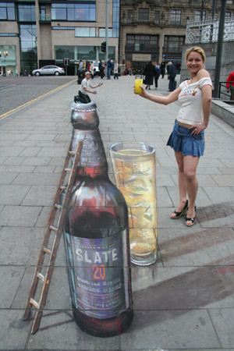
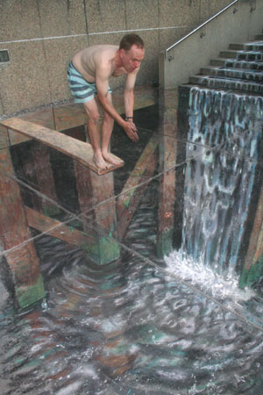
Sidewalk Art
Images by Julian Beever

Slide 46
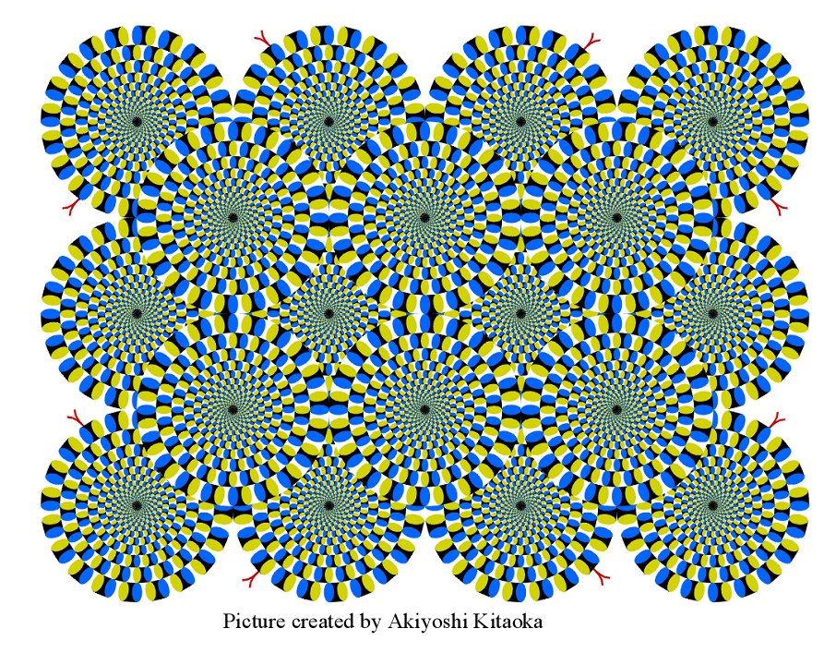
Visualization in the Periphery

Slide 47
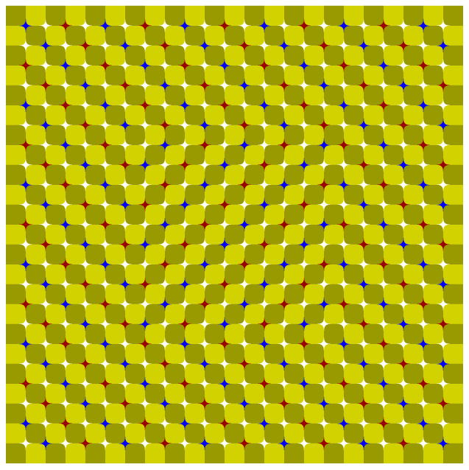
Visualization in the Periphery

Slide 48
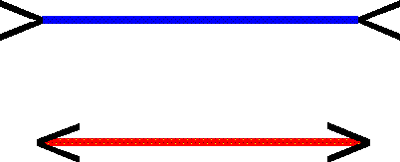
Another Illusion

Slide 49
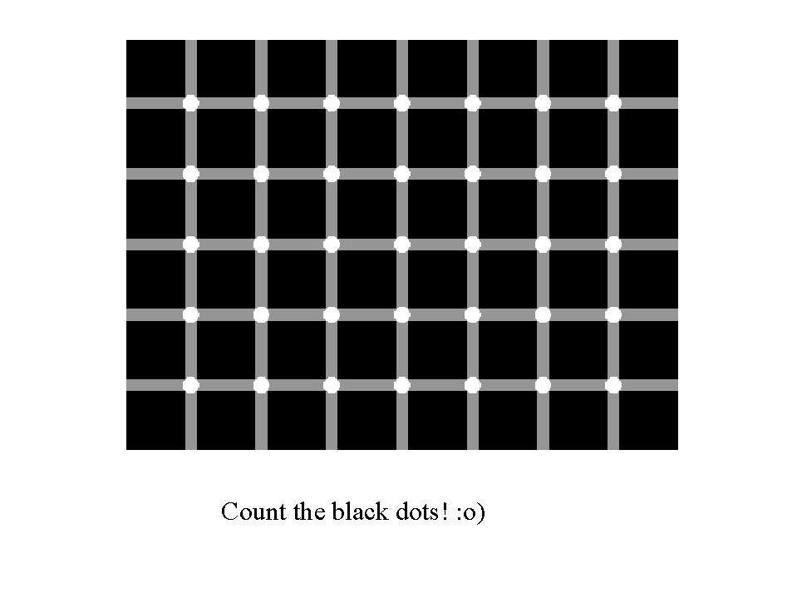
Count the Black Dots

Slide 50
Questions?

